Slide 1
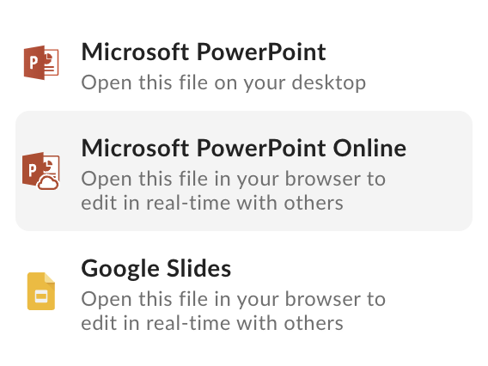
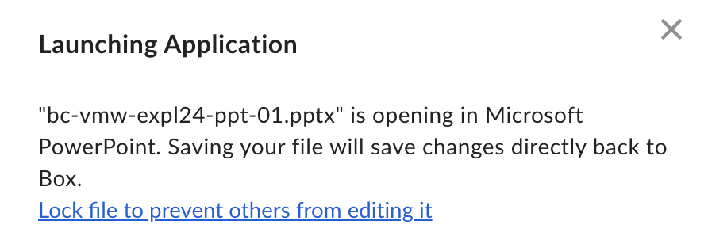
Quick Guide Start here to store and create your presentation
Use Box or save locally when storing your PowerPoint document to avoid unexpected behaviors introduced by Google Drive storage and inadvertent Google Slide conversion.
Google Slides will introduce unexpected behaviors:
Metropolis will not render correctly—a substitute Google font will replace it
Charts and graphs will lose their association with Excel documents
Animation functionality will be changed or lost
If you store your PowerPoint on Google drive, change your settings so Google Slides does not open by default:
Go to drive.google.com. Click Settings Settings
Click Manage apps.
Find Slides. Next to the app, to the left of "Use by default," uncheck the box.
How to store and share your PowerPoint on Box or locally.
Identify a location in Box and store your PowerPoint deck. Share the document with collaborators as needed.
Edit in PowerPoint. Do not edit in Google Slides.
Lock the file while you are editing it to avoid versioning issues.
Save the PowerPoint and you will see your edits reflected in the version on Box. Alternatively, you can upload a new file version.

Slide 2
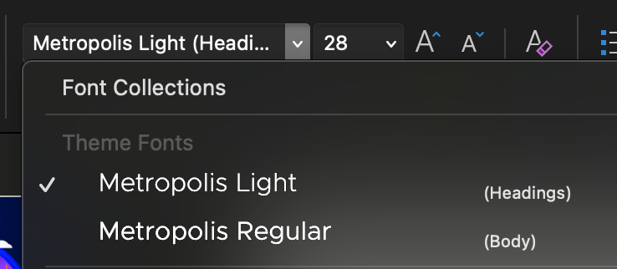
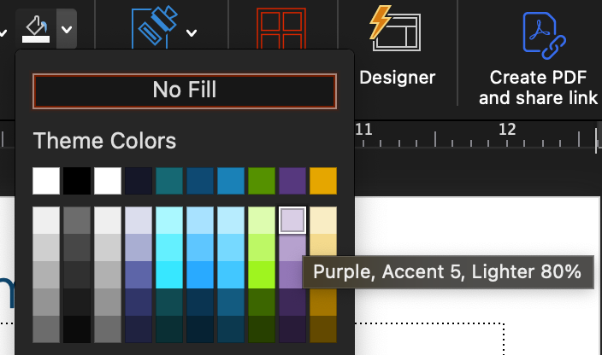
Quick Guide Start here to convert slides and avoid unexpected behavior
How to convert your existing deck to this template
Open the deck you want to convert. Copy all the slides from the deck you want to convert (select all slides in the slide view pane and copy into the slide view pane of this template deck).
Paste the slides into this Explore 2024 PowerPoint template.
Important: Select “Use destination theme” from the drop down that appears by the clipboard icon in the slide view panel.
Shifts/changes to your content should be minimal. Click through your slides. Manually adjust as needed or reassign a master slide layout that is a better fit.
There are several other methods to convert your deck. Reference the Microsoft PowerPoint Support Documentation for more information.
Known issues when converting from Broadcom PPT templates:
Title text should should be Metropolis Light, 28 (dark teal, Accent 2), not Bold
When converting from a VMware by Broadcom deck, some light gray backgrounds will default to lavender. Adjust the color manually.

Slide 3
Quick Guide Start here to create effective, on-brand content
Product Names
Always use the full product name on first use.
Don’t abbreviate product names, especially trademarked ones. Doing so consistently can jeopardize our trademark ownership.
Contact the Brand team if you have questions about how to write a product name in a small space.
Capitalization
Headlines Use Title Case: Capitalize the first letter of each word, except articles (e.g., a, the) and prepositions (e.g., with, for). Remember to capitalize “Is” in title case, because it’s a verb.
Subheads use sentence case: Only capitalize the first letter of the first word and any proper nouns (e.g., names of people, products or companies). Think about how you’d capitalize a sentence.

Slide 4
PowerCLI 201
CODE1744LV
From the Shell to Writing Scripts
Justin Sider
Chief PowerShell Officer – Belay Technologies
#CODE1744LV
Broadcom Proprietary and Confidential. Copyright © 2024 Broadcom.
All Rights Reserved. The term “Broadcom” refers to Broadcom Inc. and/or its subsidiaries.

Slide 5
In this session we will quickly review the PowerShell basics before jumping into the advanced topics of script writing. The focus will be on how to convert the UI actions into actionable PowerShell code. This session will cover the vSphere Developer center 'Code Capture' feature so that new PowerCLI users can understand how to generate their own code from the Center user interface.

Slide 6
Agenda
PowerShell Basics
What is a Script?
VMware Developer Center
PowerShell vs. C# vs. .Net
Converting Developer Center Output to Useable PowerShell/PowerCLI
Get-Help
Related Links
Get-Member
Resources

Slide 7
PowerShell Basics
PowerShell Basics

Slide 8
What is a Script?
What is a Script?

Slide 9
VMware Developer Center
VMware Developer Center

Slide 10
PowerShell vs. C# vs. .Net
PowerShell vs. C# (See Sharp) vs. .net (Dot Net)

Slide 11
Converting Developer Center Output to useable PowerShell/PowerCLI

Slide 12
Get-Help
Get-Help

Slide 13
Related Links
Related Links

Slide 14
Get-Member
Get-Member –InputObject $myobject

Slide 15
Resources
https://developer.broadcom.com/
https://community.broadcom.com/home

Slide 16
Please take your survey.
Broadcom Proprietary and Confidential. Copyright © 2024 Broadcom.
All Rights Reserved. The term “Broadcom” refers to Broadcom Inc. and/or its subsidiaries.

Slide 17
Thank You
Text
Broadcom Proprietary and Confidential. Copyright © 2024 Broadcom.
All Rights Reserved. The term “Broadcom” refers to Broadcom Inc. and/or its subsidiaries.

